Slide 1
        Energy efficiency program
        Initial Housing Provisions Jan 2003
        Multi-residential buildings May 2005
        Non-residential commercial May 2006 RD 2004-01)
        Enhanced housing measures May 2006 (RD 2004-02)

Slide 2
BCA energy efficiency philosophy
■ The underlying goal of the BCA is to reduce greenhouse gas emissions by efficiently using energy
■ This energy does not include embodied energy or other sustainability aspects at this time

Slide 3
BCA energy efficiency philosophy (cont.)
■ Who is paying for the energy?
■ What should be regulated inside a private residence?
■ Improving the performance of the building fabric and services means reducing:
■ The size of the services system
■ The peak load on the utilities
■ The hours/year usage of the services
■ The compounding effect, e.g. lighting

Slide 4
Energy efficiency
Part of the National Framework for Energy Efficiency and the Australiangovernments’ greenhouse gas reductionstrategy
♦ Australian Greenhouse Office
♦ Supported by all governments
Strategy includes:
♦ Mandatory measures
♦ Voluntary best practice measures
♦ Minimum Energy Performance Standard

Slide 5
Deemed-to-Satisfy Provisions
■ Building solutions that have been assessed for compliance with the Performance requirement
■ If compliance achieved, NO further justification is required
Alternative Solutions
■ Not identified in the BCA
■ Must be justified as complying with the Performance Requirement
■ Documentary evidence required

Slide 6
Documentary evidence
■ Registered Testing Authority report
■ Certificate:
■ Conformity or Accreditation
■ Proposed CodeMark
■ From a professional engineer
■ Issued by certification body that has been accredited by JAS-ANZ
■ SSL Product Listing Data Sheet for Fire Protection Equipment
■ Any other form of documentary evidence
Notes:
SSL Scientific Services Laboratory (Melbourne)
JAS-ANZ Joint Accreditation System of Australia and New Zealand

Slide 7
Administrative documentation
■ Certification
■ Full assessment report
■ Conditions
■ Relevant non-compliance to the DTS
■ Applicable Performance Requirements
■ Assumptions, limitations
■ References, software programs, etc

Slide 8
Energy Efficiency Performance Requirements
Part J1 – Building Fabric
Part J2 – Glazing
Part J3 – Building Sealing
Part J4 – Air Movement
Part J5 – Air-Conditioning & Ventilation
Part J6 – Artificial Lighting and Power
Part J7 – Hot Water Supply
Maintenance of Energy Efficiency Installations
Verification Methods
Administrative Matters

Slide 9
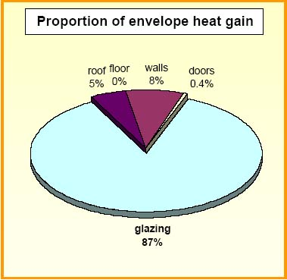
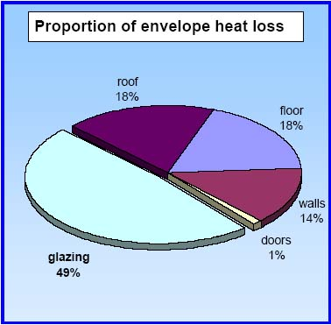
Winter heat loss or gain through the fabric of a typical dwelling
This does not include losses from a hot water service

Slide 10
Relevant definitions
■ Climate zones
■ Parts of the country with similar climatic conditions
■ Simplifies application of provisions
■ The BCA includes a map and a location table (Clause A1.1)
■ The ABCB web site has an enlargeable map
■ Envelope
■ Building fabric separating heated or cooled interior spaces from the exterior of the building or unconditioned spaces
i.e. spaces that:
■ Are habitable rooms
■ Are conditioned
■ Can be conditioned
The envelope may comprise internal or external elements

Slide 11
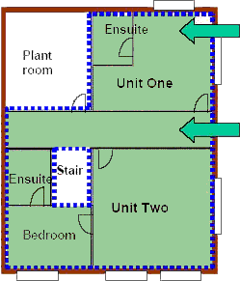
Envelope definition
Sole occupancy unit conditioned: The walls, roof, ceiling and floor may be part of the building envelope. Includes non-habitable rooms such as the ensuite.
Corridor: The walls, etc of this area are part of the envelope where there is conditioning on one side of an element and no conditioning on the other.

Slide 12
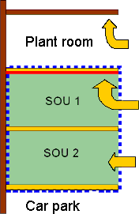
Envelope definition (cont.)
Plant room ceiling not insulated as the ceiling is not part of the building envelope
SOU below non-conditioned space: Ceiling is insulated as it is part of the envelope
Building envelope: Between conditioned spaces and non-Car park conditioned spaces
Section

Slide 13
PART J1 – BUILDING FABRIC
J1.0 DtS Provisions
J1.1 Application of Part
J1.2 Thermal construction
J1.3 Roofs and ceilings
J1.4 Roof lights
J1.5 Walls
J1.6 Floors

Slide 14
J1.1 Application of Part
■ Class 2 and 3 buildings and Class 4 parts
■ Applies to ceilings, roof lights, walls and some floors
■ Several options for compliance
■ Based on climate zones
Relevant definitions
■ Climate zones
■ Envelope
■ Total R-Value

Slide 15
J1.2 Thermal construction
■ Integrity of insulation barriers
■ Testing and labelling AS/NZS 4859.1
■ Acceptable insulation practice
■ Reference to Specification J1.2 for thermal material properties
Warning
♦ Are current thermal test reports available?
♦ Does the insulation comply with Section C for fire
resistance and fire hazard properties?

Slide 16
J1.3 Roofs and ceilings
■ Achieve nominated Total R-Value
■ Applies to building envelope
■ May be internal ceilings as well as external roofs
■ Reference to Specification J1.3 for construction options

Slide 17
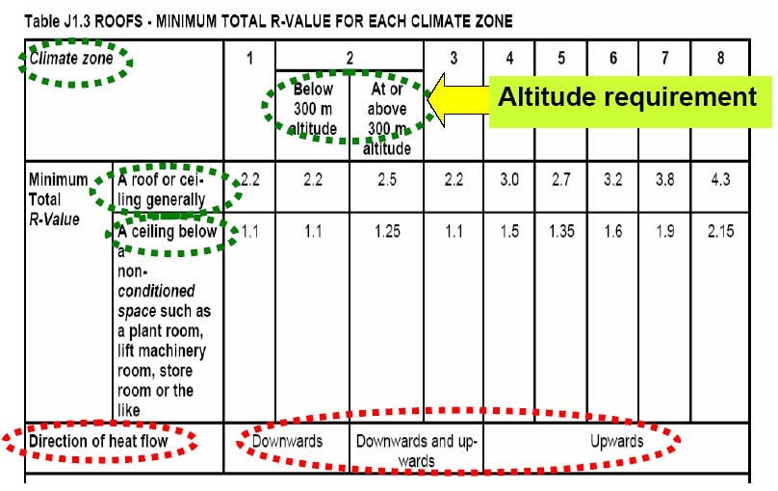
Roofs and ceilings – J1.3

Slide 18
J1.5 Walls
■ Achieve nominated Total R-Value:
■ Table J1.5
■ Applies to an envelope wall
■ The envelope wall may be internal or external
■ Exemptions:
◘ South facing walls climate zones 1 to 3
◘ Opaque doors, vents, etc

Slide 19
J1.5 Walls (cont.)
■ Reference to Specification J1.5 for construction options
■ If external envelope wall:
■ Insulation – Total R-Value
■ Shade wall in climate zones 1, 2 and 3
■ Achieve a surface density of 220 kg/m2 with or without additional requirement
■ If internal envelope wall:
■ 50% of required Total R-Value in cooler zones (4, 6, 7 & 8)
■ No requirements in other climate zones

Slide 20
Floors – J1.6
■ Suspended floors achieve: Total R-Value
■ Climate zones 6 and 7 = 1
■ Climate zone 8 = 2.5
■ All zones with in-slab heating = 1 (both underneath and the vertical edge)
■ Vertical insulation at slab edge
■ Slab-on-ground with in-slab heating
■ Climate zone 8
■ Reference to Specification J1.6 for construction options

Slide 21
Summary
■ Applies to Class 2, 3 and 4 buildings
■ Both internal & external elements
(part of the building envelope)
■ Roof and ceilings, roof lights, wall and floor construction
■ Ensure that insulation:
 Is installed correctly
 Is properly tested
 Has the required fire properties
End of Section J1

Slide 22
PART J2 – GLAZING
J2.0 DtS Provision
J2.1 Application of Part
J2.2 clause deliberately left blank
J2.3 Glazing
J2.4 clause deliberately left blank
J2.5 Shading

Slide 23
PART J2 – GLAZING (cont.)
Glazing (BCA):
Conductance:
Solar Heat Gain Heating:
SHGC:
Exposure factors (E):
“Glazing, for the purposes of Section J, means a transparent or translucent element and its supporting frame located in the external fabric of the building.”
heat transferred from a warmer to a colder surface
measures the rate of heat conduction through a material or assembly for each degree of temperature difference
caused by direct solar radiation,
Solar Heat Gain Coefficient
measure exposure to summertime solar radiation

Slide 24
PART J2 – GLAZING (cont.)
Good glazing design contributes to energy efficiency by:
■ Allowing in natural light
■ Enhancing solar heat gains in winter
■ Restricting heat losses through the glazing in winter
■ Restricting unwanted heat gains in summer or in hotter climates
Glazing (BCA definition)
“Glazing, for the purposes of Section J, means a transparent or translucent element and its supporting frame located in the external fabric of the building, and includes a window other than a roof light.

Slide 25
PART J2 – GLAZING (cont.)
Terminology and definitions
U-Value (Watts/m²×K) measures the rate of heat conduction through a material or assembly for each degree of temperature difference
■ Lower numbers are better
■ Range 6.5 – 2.0 W/m²×K
■ Reciprocal of R-Value (1/R)
Terminology and defintions
Solar Heat Gain Coefficient SHGC) measures the fraction of solar radiation that passes through glazing Always less than 1 Lower numbers are better Range 0.87 – 0.11 | Exposure factors measure exposure to summertime solar radiation. Shading can be achieved by permanent features & shading devices

Slide 26
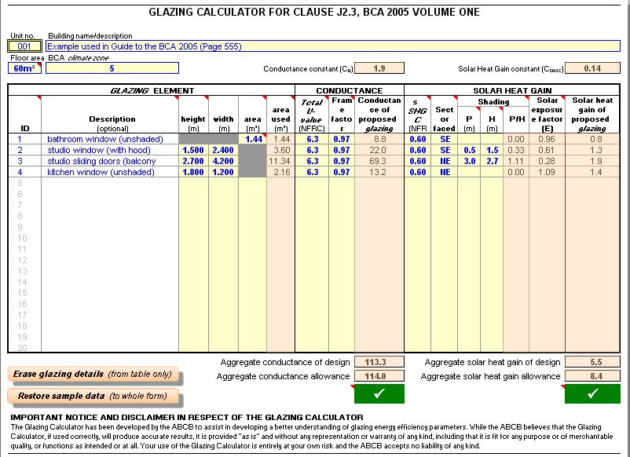
PART J2 – GLAZING (cont.)
ABCB glazing calculator
Excel spreadsheet based tool for Part J2 compliance. It determines the BCA glazing allowances, aggregate glazing conductance and aggregate glazing solar heat gain. Automatically carries out calculations and compares results for compliance

Slide 27
PART J2 – GLAZING (cont.)
Summary
■ Glazing assessed separately for:
■ Each sole-occupancy unit
■ Each public area
■ Considers the glazing area in each storey
■ Glazing aggregates not to exceed each of the BCA allowances
■ Calculations can be completed by:
■ Equations in J2.3
■ ABCB glazing calculator

Slide 28
PART J3 – BUILDING SEALING
J3.0 DtS Provisions
J3.1 Application of Part
J3.2 Chimneys and flues
J3.3 Roof lights
J3.4 External windows and doors
J3.5 Exhaust fans
J3.6 Construction of roofs, walls and floors

Slide 29
Overview of provisions
Chimneys & flues – J3.2
To be provided with damper
Roof lights – J3.3
To To be provided with a ceiling diffuser, shutter or weatherproof seal
External windows & doors – J3.4
Fitted with seals
Windows complying with
AS 2047 (Windows in Buildings) provides adequate sealing
Warning –Important change – External doors to main entrances

Slide 30
Overview of provisions (cont.)
        ■ Exhaust fans – J3.5
■ To be provided with damper
■ Kitchen range hood exempt
        ■ Roofs, external walls & floors – J3.6
■ Cornices, skirtings, etc to minimise air leakage are deemed to provide adequate sealing

Slide 31
PART J4 – AIR MOVEMENT
J4.0 DtS Provisions
J4.1 Application of Part
J4.2 Air movement
J4.3 Ventilation openings
J4.4 Ceiling fans and evaporative coolers

Slide 32
PART J4 – AIR MOVEMENT (cont.)
To reduce the use of air-conditioning by taking advantage of the cooling effect provided by:
Natural cross flow ventilation
Ceiling fans and evaporative coolers
Reduced use means reduced greenhouse gas emissions

Slide 33
PART J4 – AIR MOVEMENT (cont.)
        Application of Part J4
        Two options
■ Natural ventilation plus
■ Ceiling fan; or
■ Evaporative cooler
■ Natural ventilation plus
■ Breeze path; or
■ Two openings in the room

Slide 34
Clause J4.2 and Table J4.2
■ Climate zones 1 to 5
■ Requires ventilation openings
■ External opening in wall, floor or roof
■ Permanent opening or openable window etc
■ May be provided from adjoining room
■ Air movement requirements in Table J4.2

Slide 35
Clause J4.3 Ventilation openings
Applicable to habitable rooms without a ceiling fan or evaporative cooler
Must have either:
■ Breeze path connecting ventilation openings of another habitable room
OR
■ Minimum two separate ventilation openings in habitable room
Two ventilation openings
■ Can be provided as an alternative to a breeze path
■ Can be in the same wall

Slide 36
PART J5 – AIR CONDITIONING AND VENTILATION SYSTEMS
J5.0 DtS Provisions
J5.1 Application of Part
J5.2 Air-conditioning and ventilating systems
J5.3 Time switch
J5.4 Heating and cooling systems
J5.5 Ancillary exhaust systems

Slide 37
PART J5 – AIR CONDITIONING AND VENTILATION SYSTEMS (cont.)
Reasons for measures
■ To allow air-conditioning and ventilation
systems to use energy more efficiently
■ To ensure that inefficient equipment is not chosen
■ To take a whole-of-building approach rather than a developer & tenant approach
Administration
Proposed requirements are complex:
■ Requires specialist mechanical engineering input
■ Must be suitably qualified
■ Validate expertise before accepting documentation
■ Use manufacturer’s data sheets
■ Certification of installed systems

Slide 38
PART J5 – AIR CONDITIONING AND VENTILATION SYSTEMS (cont.)
Summary
■ Introduces new BCA requirements
■ Extensively covers air-conditioning, ventilation, heating and cooling plant
■ Requires design and testing documents
■ Certificates from experts to verify installation

Slide 39
PART J6 – ARTIFICIAL LIGHTING AND POWER
J6.0 Deemed-to-Satisfy Provisions
J6.1 Application of Part
J6.2 Interior artificial lighting
J6.3 Interior artificial lighting and power control

Slide 40
PART J6 – ARTIFICIAL LIGHTING AND POWER (cont.)
Overview
■ Reduce unnecessary use of lighting and power energy
■ Control lighting intensity
■ Encourage sensors, detectors, etc
■ Benefits:
■ Reduced heat from lighting
■ Smaller air-conditioning load

Slide 41
PART J6 – ARTIFICIAL LIGHTING AND POWER (cont.)
Summary
■ Individual switching of Class 3 lighting
■ Limit the power that may be used by lighting systems
■ Capacity and number of fittings
■ Use of occupant activated device for all powered items in Class 3 sole- occupancy units

Slide 42
PART J7 – HOT WATER SUPPLY
J7.0 DtS Provisions
J7.1 Application of Part
J7.2 Hot water supply
Summary
Applies to sanitary and cooking hot water piping systems
Requirements in AS/NZS 3500.4
Exemptions for solar water heaters in climate zones 1, 2 & 3

Slide 43
PART J7 – HOT WATER SUPPLY (cont.)
Referencing AS/NZS 3500.4, Plumbing and Drainage, Heated Water Services (Section 8)
Not applicable to heating hot water i.e. hydronic systems covered in Part J5
Summary
Applies to sanitary and cooking hot water piping systems
Requirements in AS/NZS 3500.4
Exemptions for solar water heaters in climate zones 1, 2 & 3

Slide 44
PART J 8 - ACCESS FOR MAINTENANCE
J8.0 DtS Provisions
J8.1 Application of Part
J8.2 Access for maintenance
Access must be provided to all plant, equipment and components that require maintenance in accordance with Part I2.

Slide 45
PART J 8 - ACCESS FOR MAINTENANCE (cont.)
Maintenance requirements
Two Parts:
■ Part I2 -Energy Efficiency Installations
■ Equipment that requires maintenance
■ Part J8 -Access for Maintenance
■ Requires access to carry out maintenance
BCA Clause
“J8.2 Access for maintenance
Access must be provided to all plant, equipment and components that require maintenance in accordance with Part I2.”
■ Seek guidance from manufacturers
■ AIRAH Handbook

